Slide 1


NORTHWIND TRADERS: SALES ANALYTICS
A Project Journey from Raw Data to Actionable Insights
BY KANISHK SURWADE

Slide 2

Project Objective & Details
Revolutionizing Data Interaction for Northwind Traders
The primary objective of this project was to create a visually appealing and user-friendly Power BI dashboard to effectively communicate key performance metrics for Northwind Traders.
The core aim was to move beyond static data and generate actionable insights into four key pillars of the business:
Sales Analysis: To understand revenue trends and sales patterns.
Customer Segmentation: To identify and understand key customer behaviors.
Inventory Trends: To monitor product performance and stock levels.
Employee Performance: To evaluate the contributions of the sales team.
Ultimately, this report is designed to empower all stakeholders—from sales managers to executive leadership—to make informed, data-driven decisions by facilitating data exploration through interactive visualizations and dynamic filters. The expected impact is to revolutionize how Northwind interacts with its data, enabling the company to drive its business forward and remain competitive.

Slide 3

A Strategy-First Approach: The MECE Framework
01
A project of this complexity necessitates a robust strategy before the application of any tools. The guiding philosophy for this entire endeavor was the MECE principle – which stands for Mutually Exclusive, Collectively Exhaustive.
02
This framework mandates the decomposition of a complex problem into smaller components that are non-overlapping (Mutually Exclusive) yet, in aggregate, fully address all facets of the problem (Collectively Exhaustive).
03
This principle was not merely a preliminary plan; it was the core methodology applied at every stage of the project, ensuring the analysis was structured, comprehensive, and methodologically sound."

Slide 4
Applying MECE to the Project Structure
Structuring the Analysis: The Four Pillars of the Business
The initial application of MECE was to the project's overall scope. I segmented the entire business analysis into four distinct, non-overlapping pillars:
Sales Performance: The "What" and "When" of sales.
Customer Analysis: The "Who" and "Where" of the customer base.
Supply Chain & Operations: The "From Where" and "How Efficiently."
HR & Employee Analysis: The "By Whom."
The Benefit: This structure provided a clear and logical roadmap for the entire project. It ensured a comprehensive analysis and directly informed the architecture of the final dashboard, with each page dedicated to one of these pillars."

Slide 5
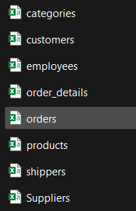
Phase 1 - Data Transformation (Excel)
Step 1: Preparing the Foundation in Excel
01
What We Did: The project began with the processing of eight raw CSV files. The initial data preparation phase was conducted using Microsoft Excel.
02
MECE Was Applied: Each file was treated as a discrete, 'mutually exclusive' task to ensure focused and accurate cleaning. The most critical transformation was the creation of a Revenue column in the order_details file.
03
Its Benefits: By isolating and pre-calculating this core metric at the outset, we optimized the entire downstream process. This is a prime example of MECE thinking. The benefit was a significant improvement in the performance and simplicity of all subsequent SQL queries, which reduced processing time and minimized the potential for errors."

Slide 6
Phase 2 - Exploratory Data Analysis (MySQL)
Step 2: Uncovering Deep Insights with SQL
01
What We Did: Following the data preparation phase, the cleaned files were loaded into a MySQL database. I then executed a series of complex SQL queries to address the 15 predefined Exploratory Data Analysis (EDA) questions.
How MECE Was Applied: The 15 EDA questions were categorized into our four established pillars. This methodology allowed for a systematic and focused exploration of the data, tackling one domain at a time—from customer demographics to sales trends—ensuring the analysis was 'collectively exhaustive.'
02
Why It's Important & Its Benefits: This structured approach prevented a random or haphazard querying process. It allowed us to build a coherent narrative about the business, where each insight became a crucial building block for the final dashboard design."
03

Slide 7
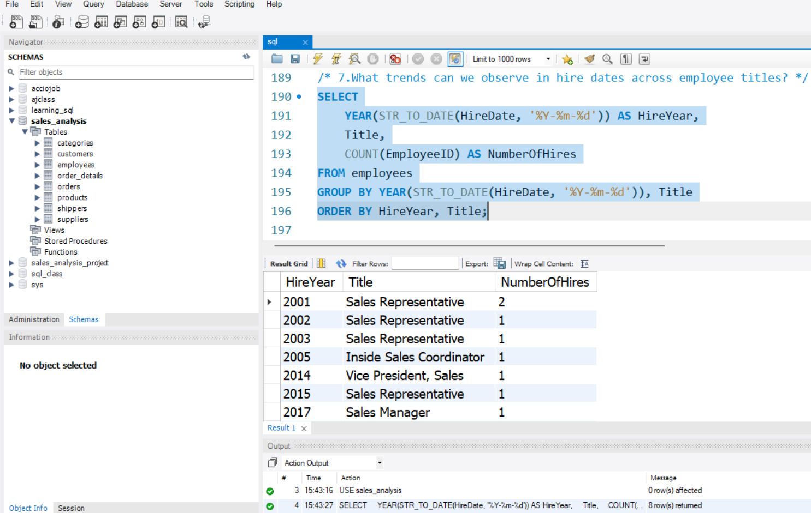

Slide 8
Phase 3 - Validating Insights in Excel
Step 3: Rapid Prototyping & Insight Validation in Excel
01
What We Did: After executing each SQL query, I performed an essential intermediate step. I pasted the raw output from MySQL directly into Excel. For each of the 15 questions, I then created quick, focused visuals using Pivot Tables and Charts.
How MECE Was Applied: This step is a practical application of the MECE principle at the micro-level. Each Excel sheet became a 'mutually exclusive' container for a single, isolated insight. This allowed me to validate the answer to one question at a time, ensuring each piece of the analysis was correct and told a clear story on its own.
02
03
Why It's Important & Its Benefits: This is a critical quality assurance and rapid prototyping phase. Before investing time in designing a polished Power BI visual, I could quickly generate a simple chart in Excel to confirm that the data was logical and the insight was sound. This process de-risked the final dashboarding stage and helped refine the analytical narrative."

Slide 9
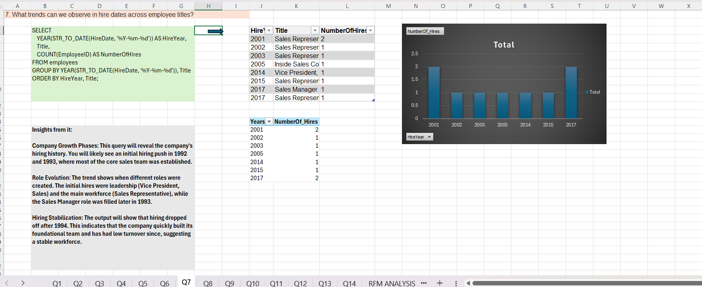

Slide 10
Phase 4 - Telling the Story with Power BI
Visualizing the Final Narrative in Power BI
01
What We Did: With our insights validated, the final phase was to construct the interactive dashboard in Power BI.
02
How MECE Was Applied: The architecture of the final dashboard is a direct reflection of our original four-pillar framework. I created a separate, dedicated page for each analytical domain: an Executive Summary, a Customer deep-dive, a Sales analysis, and so on. Each page functions as a self-contained, 'mutually exclusive' yet 'collectively exhaustive' view of its topic.
03
Why It's Important & Its Benefits: This design makes the final report exceptionally user-friendly. A stakeholder can navigate directly to the page relevant to them and find all the information they need, without being encumbered by unrelated data. This structure ensures the right insights are delivered to the right audience with maximum clarity."

Slide 11
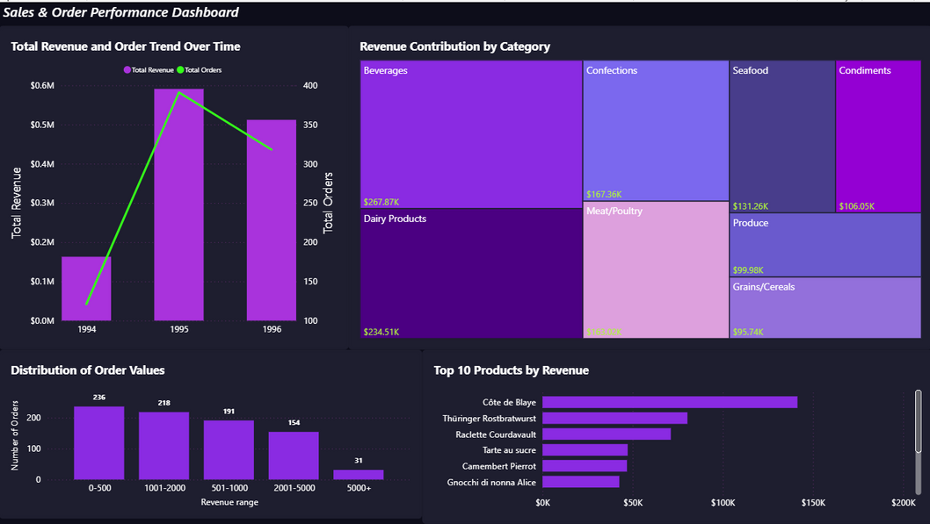
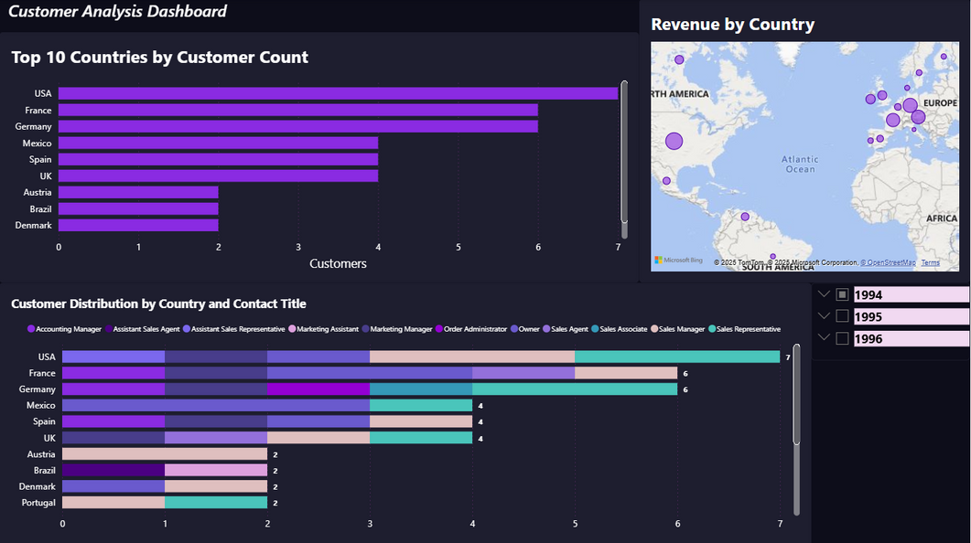
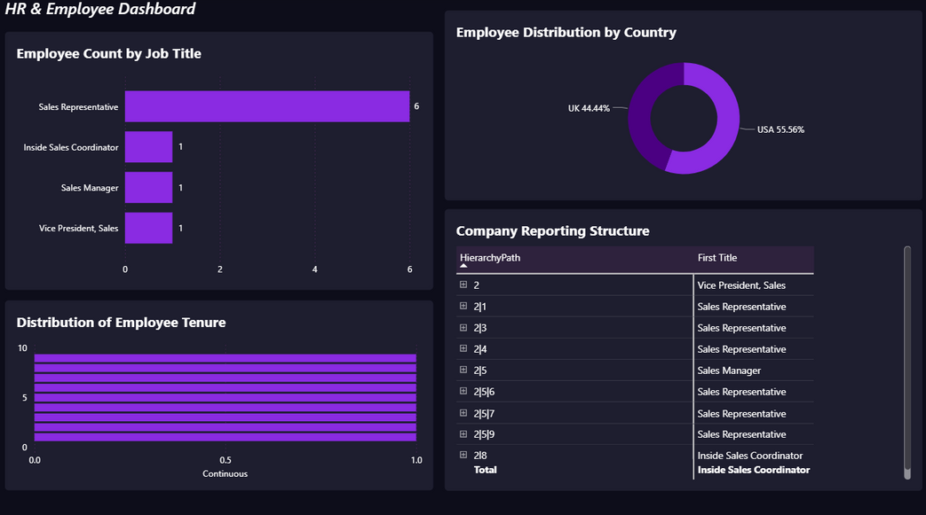
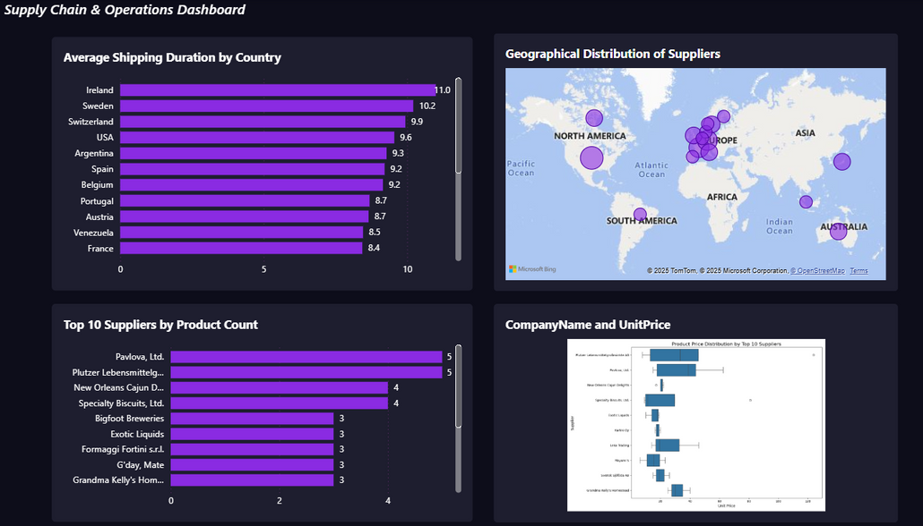

Slide 12
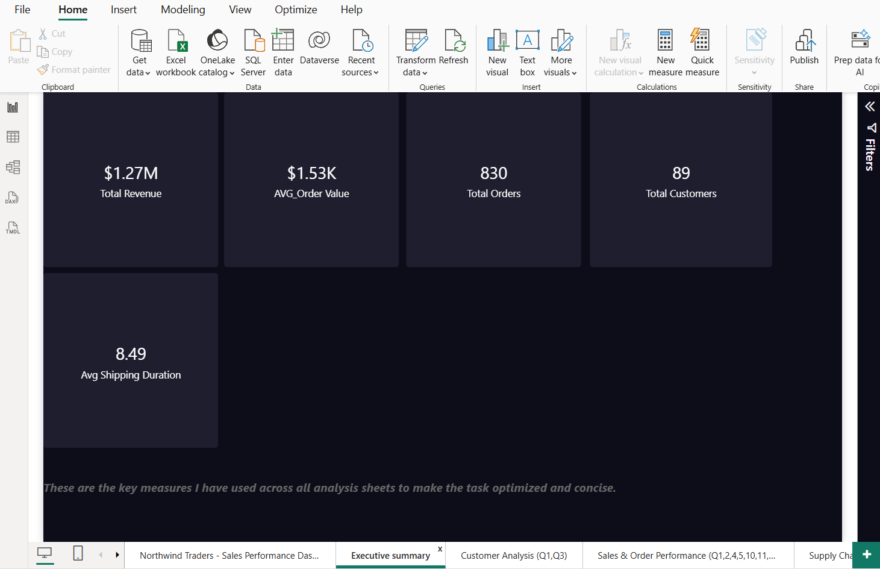
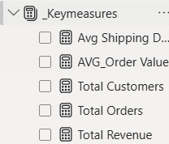
These are the key measures I have used across all analysis sheets to make the task optimized and concise.

Slide 13
DASHBOARD INSIGHTS: CUSTOMER & SALES DYNAMICS
Key Findings: The External View - Customers and Sales
01
The dashboards yielded several critical external insights:
Customer Analysis: Our customers are primarily other businesses, with 'Owners' and 'Sales Representatives' as the most common roles. Geographically, the business is heavily concentrated in the USA and Germany.
Sales Performance: There is a distinct seasonal pattern, with sales consistently peaking in the fourth quarter. Furthermore, Beverages and Dairy Products were identified as the highest-performing categories.
02
The Benefit: These are strategic directives. This intelligence informs where to focus marketing expenditure and how to optimize inventory for seasonal demand."

Slide 14
DASHBOARD INSIGHTS: OPERATIONS & INTERNAL PERFORMANCE
Key Findings: The Internal View - Operations and People
01
Looking internally, the dashboards revealed:
Supply Chain & Operations: Our supply chain is geographically concentrated in specific regions like Europe and the USA, which is a potential risk. We also identified key suppliers who are specialists in critical categories.
HR & Employee Analysis: The data confirms we are a sales-driven organization with a stable and experienced team, operating from dual hubs in Seattle and London.
02
The Benefit: These insights highlight areas for operational improvement, such as diversifying the supply chain to reduce risk, and confirm the strength of our experienced sales team."

Slide 15
EXTRA ANALYSIS - RFM SEGMENTATION IN EXCEL
Going Beyond: Actionable Customer Segmentation with RFM
01
What We Did: To deliver additional value, I conducted a bonus RFM analysis, a standard industry technique that segments customers based on their Recency, Frequency, and Monetary behavior.
How MECE Was Applied: The RFM model is, in itself, a MECE framework. It segments the entire customer base into distinct, non-overlapping groups like 'Champions,' 'At Risk,' and 'Lost Customers.'
Why It's Important & Its Benefits: This elevates the analysis from descriptive reporting to predictive strategy. The marketing team can now execute hyper-targeted campaigns: reward the 'Champions,' re-engage the 'At Risk' customers, and cease spending on those who are 'Lost'."
02

Slide 16
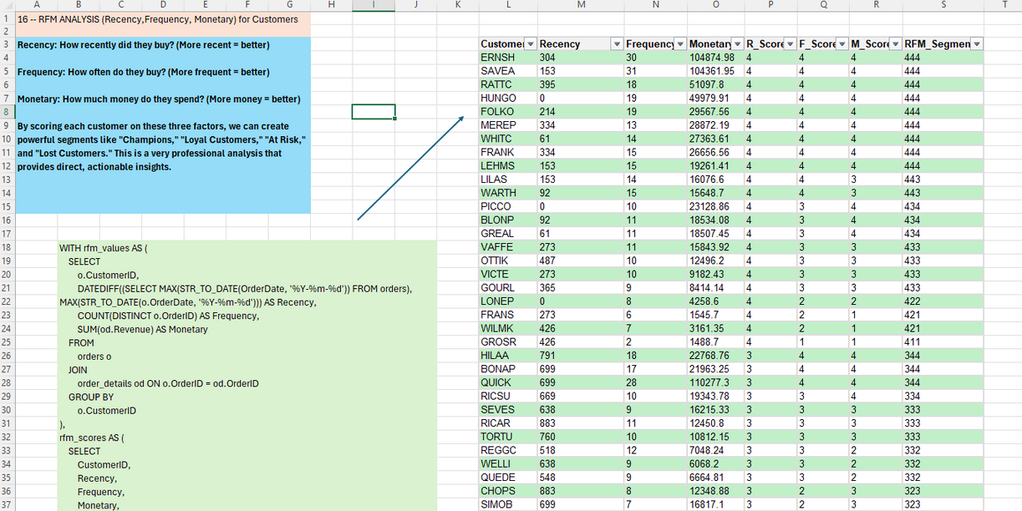
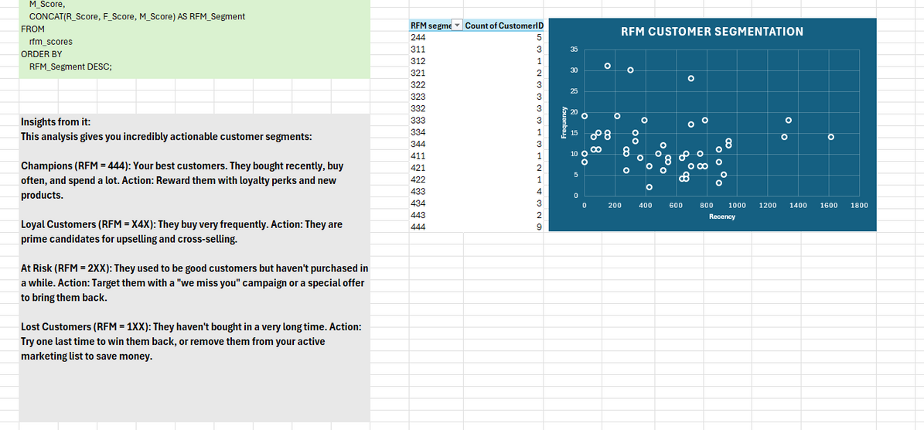

Slide 17
Conclusion & Recommendations
Conclusion: From Disparate Data to Cohesive Strategy
01
In conclusion, this project represents a complete journey through the data analysis lifecycle. Guided at every stage by the MECE principle, we successfully transformed a collection of raw data files into a powerful, interactive business intelligence tool. The primary benefit is that Northwind Traders now possesses a 360-degree view of their business, enabling a shift to proactive, data-driven strategy.
02
Based on our findings, my key recommendations are to Northwind traders :
Intensify Focus on High-Value Markets
Implement a Targeted Loyalty Program
Optimize Inventory for Seasonality
Diversify the Supply Chain"

Slide 18



